Slide 1
Diffusion of gasses
Dr Tania Warnakulasuriya
Department of Physiology

Slide 2
Diffusion of gasses
Movement of gas from an area of higher concentration to an area of lower concentration.
This occurs as a result of the kinetic properties of gas molecules.
This passive process allows the gasses to be distributed evenly between two areas.

Slide 3
Diffusion of gasses
At Rest in a normal adult
With each breath 350ml of air reach the lungs
(tidal volume-dead space).
Gases move from alveoli to blood and vice versa along the concentration gradient.
Blood traverse the lung capillaries with in 0.75s.

Slide 4
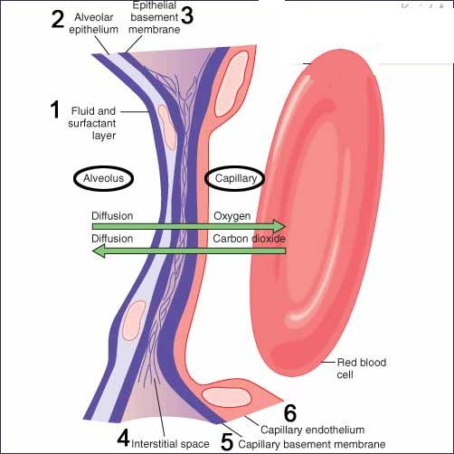
Diffusion of gasses Alveolar capillary membrane
Thickness of the respiratory membrane is 0.6µm.

Slide 5
Diffusion of gasses Fick’s law of diffusion
Diffusing capacity is determined by
Partial pressure difference of gas (∆P)
Surface area (A)
Solubility of gas (d)
Thickness of alveolar capillary membrane (d)
Molecular weight of gas (MW)

Slide 6

Diffusion of gasses
D ∆P x A x S
d x √MW
D-Diffusion rate (ml/min)
∆P-Partial pressure difference of gas
A-Surface area
S-Solubility of gas
d-Thickness of alveolar capillary membrane
MW-Molecular weight of gas

Slide 7
Diffusion of gasses
Partial pressure – Proportionate of pressure caused by a gas alone in a mixture of gas.
Eg: O₂ , N₂ , CO₂
Depends on the concentration of the gas
Diffusion is directly proportionate to partial pressure of gas

Slide 8
Diffusion of gasses
When the gas is dissolved in a liquid ( water, plasma or tissue fluid) the solubility coefficient of the gas also affect the partial pressure
Partial Pressure= Concentration of dissolved gas
Solubility Coefficient

Slide 9
Diffusion of gasses
Net diffusion of gases occur from area of high partial pressure to area of lower partial pressure
Partial pressure of gasses in alveoli depend on
Rate of ventilation.
Rate of absorption into blood/ removal from alveoli.

Slide 10
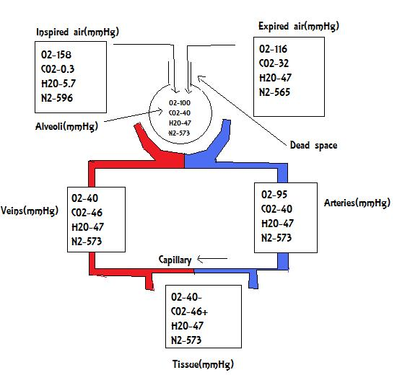

Slide 11
Diffusion of gasses
Gas | Atmospheric air | Alveolar air | Expired air
N₂ | 78.62% | 74.9% | 74.5%
O₂ | 20.84% | 13.6% | 15.7%
CO₂ | 0.04% | 5.3% | 3.6%
H₂O | 0.50% | 6.2% | 6.2%

Slide 12
Diffusion of gasses
Gas exchange will only occur if there is a difference in partial pressure between the respiratory membrane.
Once equilibrium is reached exchange stops.
Uptake of a gas depend on the reaction of that gas with substances in blood with in that time. (Haemoglobin)

Slide 13
Diffusion of gasses
Flow/Perfusion limited gas (eg:N₂O)
Do not react with Hb or are slow to react with Hb.
Reach equilibrium quickly.
Need new blood for diffusion to occur.

Slide 14
Diffusion of gasses
Diffusion limited gas (eg: CO)
React with Hb quickly.
Reach equilibrium slowly or not at all.
Diffusion capacity of the gas determine exchange between alveolar air and blood.
Not governed by perfusion.

Slide 15
O2
CO₂
Diffusion limited
Perfusion limited

Slide 16
Diffusion of gasses
When the rate of O₂ absorption to blood increase (eg: exercise) the rate of ventilation increase to maintain the alveolar partial pressure of O₂.
When more CO₂ is produced more than usual the ventilation should increase to remove it.

Slide 17
Diffusing capacity
The volume of gas that will diffuse through the membrane each minute for a partial pressure difference of 1mmHg

Slide 18
Diffusing capacity
Diffusion capacity for O₂ in an adult is 21ml/min/mmHg
PP difference of O₂ at the respiratory membrane at rest is 11mmHg
21x11=320ml of oxygen diffuse through the respiratory membrane.
This equals the rate of O₂ consumption during the resting state.

Slide 19
Diffusing capacity
CO₂ has x20 times the diffusion capacity as O₂ .
400-450ml/min/mmHg
WHY?
CO₂ has a high solubility, thus a high diffusion coefficient.
diffusion coefficient =S
√MW

Slide 20
Diffusion of gasses Fick’s law
D
D ∆P x A x S
d x √MW
D-Diffusion rate (ml/min)
∆P-Partial pressure difference of gas
A-Surface area
S-Solubility of gas
d-Thickness of alveolar capillary membrane
MW-Molecular weight of gas

Slide 21
Conditions affecting diffusion of gasses
Reduced partial pressure difference of gas –
Respiratory arrest central/peripheral
Obstructive lung disease

Slide 22
Conditions affecting diffusion of gasses
Reduced Surface area – Hemithoracotomy
Emphysema
Lung collapse

Slide 23
Conditions affecting diffusion of gasses
Increased thickness of alveolar capillary membrane –
Lung fibrosis
Pulmonary oedema

Slide 24
SUMMARY
Gas transfer in lungs is by simple diffusion.
Follows Fick’s law of diffusion.
Oxygen is perfusion dependent so blood flow to lung is important.
D
D ∆P x A x S
d x √MW

